Slide 1

Session 9-10
Present options for risk management strategies for approval
Document approved risk management strategies

Slide 2
Present options for risk management strategies for approval
In the previous sessions, we discussed about the various control types and functions
There may be many different controls to mitigate a threat, selecting the most suitable option(s) will be beneficial to the organisation.
These options will each have their pros and cons. An analysis on them will allow a more informed decision to be made.

Slide 3
Present options for risk management strategies for approval
Discussion: What are some of the options that we can consider if we want to prevent a malicious USB drive from being connected to the workstation?
With the options that you came up with, what are the pros and cons? Which control(s) will you choose at the end of the day?

Slide 4
Present options for risk management strategies for approval
In order for management to make a decision on the control, they options to be presented to them clearly. That is, just facts about the options so that they can map it to the business strategies.
There are many different ways for security options to be presented. All of them share the same factors- concise and clarity of the potential controls to be implemented.

Slide 5
Present options for risk management strategies for approval
Best practices to presenting options:
Use visual representation as compared to a wordy report.
Include selection criteria that you have applied: Cost, benefits, implementation time etc.
Highlight key factors relating to the options presented
Quantify factors wherever possible.

Slide 6
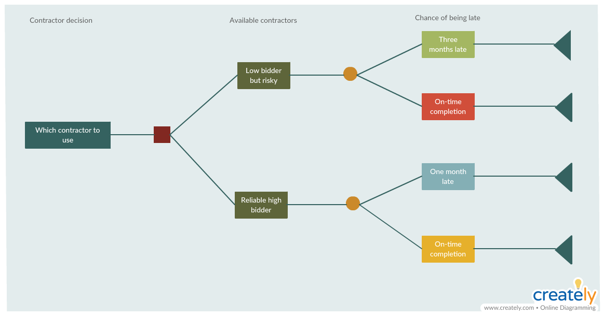
Present options for risk management strategies for approval
Decision Tree Diagram
Decision trees are used to make decisions when you are faced with multiple options. It allows you to assess the values of outcomes and possibilities of achieving them. This, in turn, helps make a better decision.

Slide 7
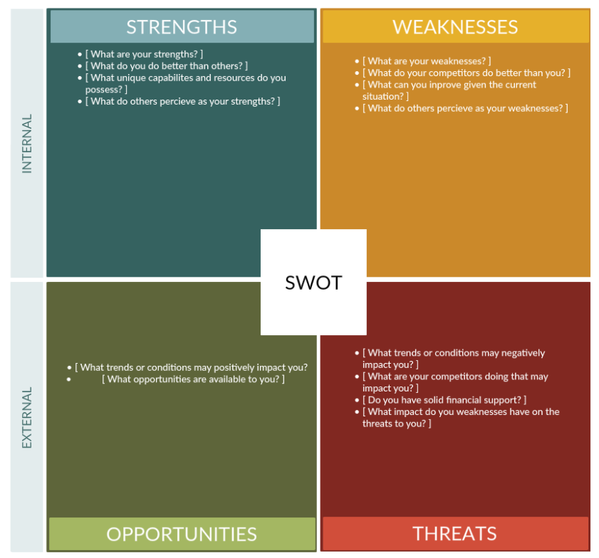
Present options for risk management strategies for approval
SWOT analysis
Whether you are planning a new project or developing a new process, a SWOT analysis can help you get insight into any risks that may occur. It helps you identify the Strengths, Weaknesses, Threats and Opportunities associated with the event.

Slide 8
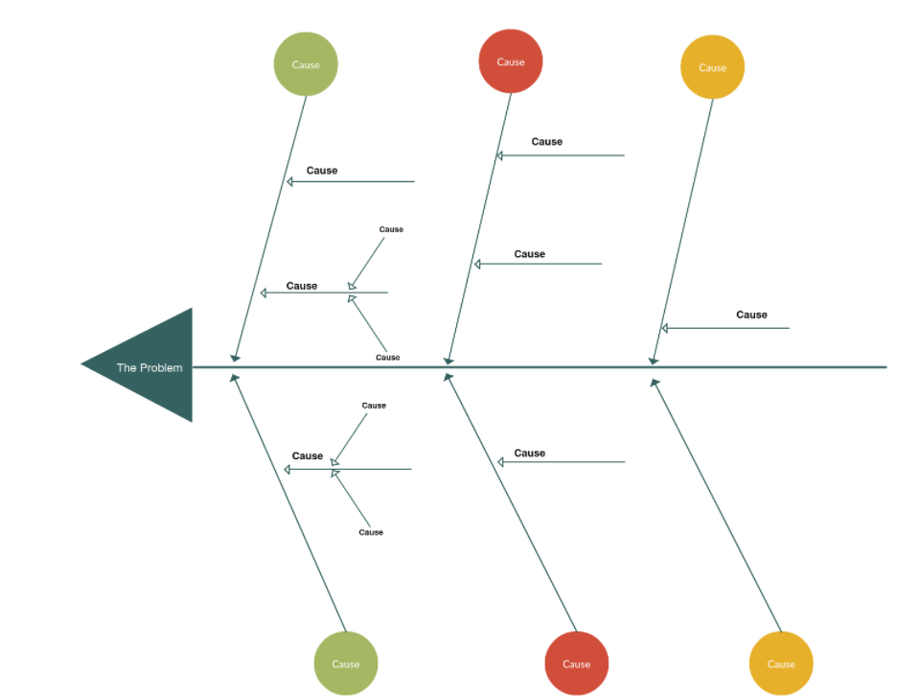
Present options for risk management strategies for approval
Fishbone Diagram
Also known as the Ishikawa diagram and the cause and effect diagram, the fishbone diagram is used to break apart a problem and identify the root causes behind it. It works backward as it helps identify the causes of a certain effect. This is useful for presenting multiple options in a diagram.

Slide 9
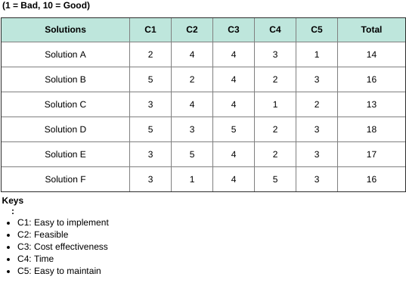
Present options for risk management strategies for approval
Selection Criteria Template
An analysis of all the potential options can be mapped on to the key selection criteria that you have decided in order to present a quantifiable table. This method of presentation is especially useful if you are selecting a product or solution as compared to a procedure.

Slide 10
Document approved risk management strategies
Once the options have been presented and approved, they need to be documented to make it a formal process.
Documenting approved risk management strategies provides illustrates management support and buy-in to the implementations.
It also provides a written piece of information for new and existing employees to understand more about the details for the strategies.

Slide 11
Document approved risk management strategies
When you have completed writing your document it is important that you have it checked for completeness and correctness.
This check should be completed by the person who wrote the document, but also by someone else trusted to review.

Slide 12
Document approved risk management strategies
Major things to check when creating documentation:
Style
Format
Grammar and Spelling
Layout
Accuracy
Final Proof

Slide 13
Security documentation structure, style, and format
The style of the document.
Depending on the document written it needs to have the correct style. If you’re creating a high level security policy the right terminology needs to be used. Whereas, if you’re writing a set of instructions then the right tone and voice needs to be used to best suit that need.
Ensure what is written matches the purpose, and is in the right style for the document.

Slide 14
Security documentation structure, style, and format
The formatting of the document.
Headings and sub headings need to be consistent through out the document. The document should flow from one point to another in a easily understandable manner.
A common type face should be used for the document with BOLD or ITALIC used when drawing attending to information.
The use of lists and bullet points can create succinct data flow when used correctly.

Slide 15
Security documentation structure, style, and format
The grammar and spelling in the document.
Ensuring that you have the correct dictionary set will help with correct spelling and formatting for your location. Using the correct word for the meaning needs to be checked as often incorrect words can be used. For example, affect and effect, lose and loose, compliment and complement.

Slide 16
Security documentation structure, style, and format
The layout of the document.
Look at how the document is set out and make sure that it looks correct and complete. For example is the logo in the right place, are the margins consistent, is there enough white space to make sure its readable.
Layout and spacing will make your document more readable for the reader and help to get your point across.

Slide 17
Security documentation structure, style, and format
The accuracy of the document.
It is important that all statements are accurate in your document. If you are not sure if something is correct ask for a reference so that it can be verified.
Things written in your document are a reflection of you and your business. You want it to be correct and shown in the best light.
In some instances you may need to have your document checked by a legal department before it is released due to the nature of the information presented.

Slide 18
Security documentation structure, style, and format
The final proof of the document.
When you have completed the step previous it is important that you check that your document still makes sense, and start the check from start to finish again.
It helps to read the document silently to yourself and also out loud to get a different perspective. Here you would also have someone else check the document.

Slide 19
Identifying appropriate reporting methods for target audience
When you have your approved security controls and completed some analysis on how you want to implement those strategies, you want to document it so that the relevant audience knows what the approved strategies are.
If already in place, templates should be used to give your document a consistent appearance. Your report will be representing your work, so you want it to look good.
When you document your strategies, think of your audience and make sure you write it in the correct language. Watch your terminology and ensure they will be able to understand what you write.
If you’re writing for a technical audience, jargon may be fine, but if it is to management or a general audience, it should be in a general level of language.

Slide 20
Reporting based upon organisational requirements and obligations
When you create the documentation of approved strategies, it is important to keep in mind you are writing a promise of work. You need to be able to deliver on what you are recommending.
Based on what you write, and what is agreed upon you will need to carry out that work.
It is important you can identify the strategies clearly and how they should be implemented. Who is responsible for the implementation and resources that are required.

Slide 21
Questions?

